Slide 1
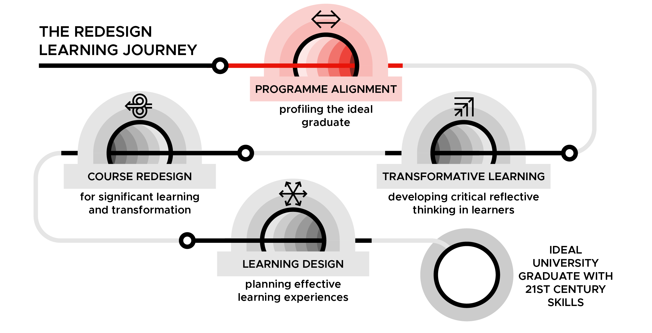
Programme Alignment – Profiling the ideal graduate
DAY 2

Slide 2
Recap of Day 1: What stood out from the presentations yesterday
PA Slide 2.2

Slide 3
Day 2: Creating alignment across the university to shape our ideal graduate
PA Slide 2.3

Slide 4
Day 2: Learning outcomes
By the end of Day 2 you will be able to:
1. Profile an ideal graduate with 21st century skills for your university
2. Evaluate the alignment between university and faculty mission outcomes; faculty mission outcomes and programme learning outcomes; and programme learning outcomes and courses (curriculum) in a programme
3. Identify how your faculty and programme contribute to the ideal graduate
PA Slide 2.4

Slide 5
Prioritising gender
Gender is a cross-cutting issue
Gender is key in development today
Gender inequalities in higher education are often present but not recognised or acknowledged
PA Slide 2.5

Slide 6
Prioritising gender
Gender inequalities and barriers in higher education:
Have huge implications for countries in terms of their future labour force and the next generation of leaders
Perpetuate discrimination and create different future pathways for men and women
Prevent the creation and use of knowledge and research that can enable inclusive, just and sustainable development.
PA Slide 2.6
Notes:
Reference: Gollifer, S., Gorman, S., Hamisi, M., Fabian, F., Kilonzo, R., Bottomley, R., Walker, J., Dennis, A., Chapin, J., Reggev, M., Friis Laustsen, C. (2018). Gender Mainstreaming in Higher Education Toolkit, INASP. https://www.inasp.info/gendertoolkit

Slide 7
Gender-responsive pedagogy
Pedagogy as a concept embraces virtually all teaching and learning processes. Within the context of classroom settings, pedagogy is a term that includes what is taught (the content), how teaching takes place (the teaching process) and how what is taught is taught (the teaching methods).
Gender responsive pedagogy refers to teaching and learning processes that pay attention to the specific learning needs of female students and male students.[1]
[1]Adapted from definitions in Mlama, P., Dioum, M., Makoye, H., Murage, L., Wagah, M., Washika, R. (2005). Gender Responsive Pedagogy (GRP): A Teacher's Handbook, Forum for African Women Educationalists. https://issuu.com/fawe/docs/gender_responsive_pedagogy_-_a_teac
PA Slide 2.7

Slide 8
Gender-responsive pedagogy: a definition
The learning needs of male and female learners are addressed in teaching and learning processes (inside and outside of the classroom)
Teaching staff are gender-aware and gender-responsive in their planning and facilitation of courses, and are continuously reflecting and adapting.
PA Slide 2.8

Slide 9
Gender-responsive pedagogy
As an instructor, you have a responsibility to create opportunities for all students, women and men, to learn to the best of their abilities.
In order to do this, it's not necessary to undermine ideas that are fundamental to your culture. But it is necessary to understand how those ideas influence your teaching practices, and the opportunities for learning that students have.
PA Slide 2.9

Slide 10
Gender terms
Sex and gender
Gender equality and equity
Gender bias
PA Slide 2.10

Slide 11
Sex and Gender
Sex
Is a fact of human biology and refers to a person’s biological status: we are born male, female or intersex (this refers to atypical features that usually distinguish male from female such as sex chromosomes, internal reproductive organs and external genitalia).
Gender
Refers to the roles, activities, attitudes, feelings, and behaviors that a given culture associates with a person’s biological sex; in other words, that a given society considers appropriate for men and women.
PA Slide 2.11

Slide 12
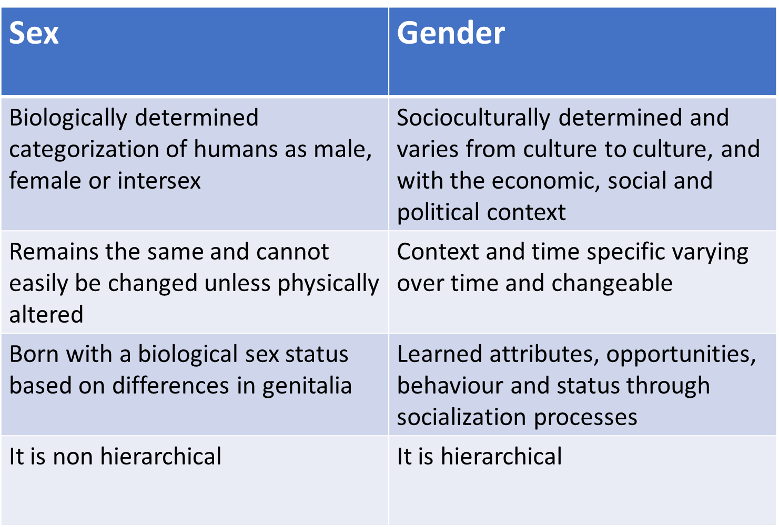
PA Slide 2.12
Notes:
Table reproduced from Gollifer, S., Gorman, S., Hamisi, M., Fabian, F., Kilonzo, R., Bottomley, R., Walker, J., Dennis, A., Chapin, J., Reggev, M., Friis Laustsen, C. (2018). Gender Mainstreaming in Higher Education Toolkit, INASP. https://www.inasp.info/gendertoolkit

Slide 13
Gender equality and equity
Gender equality
Equality between men and women…does not mean that women and men have to become the same, but that their rights, responsibilities and opportunities will not depend on whether they were born male or female.
Gender equity
Fairness of treatment for men and women according to their respective needs. This may include equal treatment or treatment that is different, but which is considered equivalent in terms of rights, benefits, obligations, and opportunities
Pavlic, B., Ruprecht, L., Sam-Vargas, S., 2000
PA Slide 2.13
Notes:
Full slide reference: Pavlic, B., Ruprecht, L., Sam-Vargas, S. (2000). Gender equality and equity: a summary review of UNESCO's accomplishments since the Fourth World Conference on Women, Beijing 1995. UNESCO. https://unesdoc.unesco.org/ark:/48223/pf0000121145

Slide 14
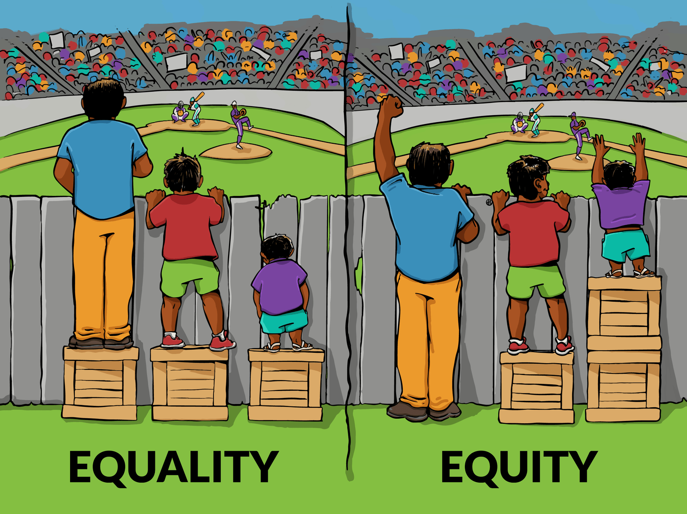
PA Slide 2.14
Notes:
Image by “Interaction Institute for Social Change | Artist: Angus Maguire.” https://interactioninstitute.org/illustrating-equality-vs-equity/

Slide 15
equ(al)ity
equality = the end goal
equity = the means to get there
PA Slide 2.15

Slide 16
Gender bias
Refers to the unfair difference in treatment of women, girls, men and boys because of prejudiced actions or thoughts related to their gender.
PA Slide 2.16

Slide 17
The Ideal Graduate Profile
Step 1
What characteristics are embedded in the vision, mission and core values of the university that should define the ideal graduate of the university?
What competencies, core values, and habits of mind should your university graduates have based on the vision and mission statements?
PA Slide 2.17

Slide 18
The Ideal Graduate Profile
Step 2
What does the feedback from the external stakeholders mean in terms of the skills, competencies and habits of mind your graduates will need when leaving your university?
What skills, competencies and habits of mind are your university currently imparting to students that should be maintained?
What skills, competencies, and habits of mind that students require are currently not being imparted by your university?
PA Slide 2.18

Slide 19
The Ideal Graduate Profile
Step 3
Referring back to the sessions yesterday looking at how the university is promoting itself, the gender responsiveness of the university environment and Quality Assurance standards:
Are there any takeaways from these sessions which need to be incorporated into the list of competencies, core values and habits of minds of your ideal graduate profile?
Will your current list of competencies, core values and habits of minds speak equally to both male and female students? If not, are there any adjustments you need to make?
PA Slide 2.19

Slide 20
The University Promise
Visualise a first-year student and then think of them as they graduate….
Based on the Ideal Graduate Profile:
What would the ideal graduate from the university look like 5 years from graduation?
How can this be expressed in one coherent statement?
PA Slide 2.20

Slide 21
The University Promise
Gallery walk:
Are there any elements in the suggestions which you particularly like? Which and why?
Are there any elements in the suggestions which you do not like? If so, which and why?
PA Slide 2.21

Slide 22
The University Mission
Revolves around
Students
Research
Teaching and learning
Knowledge
Excellence
Community
The world
PA Slide 2.22

Slide 23
What is an outcome?
An outcome is at the level of performance and achievement, can be measured, and relates to a process or an output.
PA Slide 2.23

Slide 24
Examples of learning outcomes
Students analyse experimental data and interpret results in the cellular and molecular sciences.
Students discriminate musical quality based on sound musical reasoning.
PA Slide 2.24

Slide 25
Example university mission outcomes
United States International University Africa
Mission Statement:
“To promote the discovery and application of knowledge, the acquisition of skills and the development of intellect and character in a manner that prepares students to contribute professionally, effectively and ethically as citizens of a changing and increasingly technological world.”
Mission Statement Outcomes:
Higher order thinking;
Literacy;
Global understanding and multicultural perspective;
Preparedness for career;
Community service and development.
Leadership and ethical behavior
PA Slide 2.25

Slide 26
Backwards design
The ideal university graduate profile
Each level informs the level below it.
Design process
University
Mission, Vision and Core Values; Mission Statement Outcomes
Faculty
Mission and Vision;
Mission Statement Outcomes
Programmes
Programme Learning Outcomes
Courses
PA Slide 2.26

Slide 27
Comparing the University Vision and Mission with those of your faculty
Are key elements of the University Vision, Mission and Core Values currently reflected in the Vision and Mission of your faculty?
If not, what is missing and how might the Vision and Mission of your faculty need to be revised?
PA Slide 2.27

Slide 28
The Faculty Promise
Visualise a first-year student and then think of them as they graduate….
Based on the Faculty Vision and Mission and the University Promise:
Who will a student become after completing a programme from your faculty?
What competencies, core values and habits of mind should a graduate from your faculty exhibit in their life and in the world of work?
PA Slide 2.28

Slide 29
Aligning Faculty Mission Outcomes with University Mission Outcomes
University mission outcomes
UMO 1
UMO 2
UMO 3
UMO 4
UMO 5
Faculty
mission outcomes
FMO 1
X
X
FMO 2
X
X
FMO 3
X
FMO 4
X
X
FMO 5
X
PA Slide 2.29

Slide 30
Faculty alignment reflection (groups)
How well are your faculty mission outcomes aligned to the mission outcomes for your university?
Are there any university mission outcomes that your faculty mission outcomes are currently not contributing to? If so, what changes might you need to make to your faculty mission outcomes?
Based on the above, what, if any, changes might you need to make to the vision and mission for your faculty?
PA Slide 2.30

Slide 31
Faculty alignment reflection (plenary)
How well did you faculty mission outcomes align with the university mission outcomes?
What if any changes do you need to make to the vision and mission statement as well as mission outcomes for your faculty?
PA Slide 2.31

Slide 32
Backwards design
The ideal university graduate profile
Each level informs the level below it.
Design process
University
Mission, Vision and Core Values; Mission Statement Outcomes
Faculty
Mission and Vision;
Mission Statement Outcomes
Programmes
Programme Learning Outcomes
Courses
PA Slide 2.32

Slide 33
Aligning Faculty Mission Outcomes with Programme Learning Outcomes
Faculty Mission Outcomes
FMO 1
FMO 2
FMO 3
FMO 4
FMO 5
Programme Learning outcomes
PLO 1
X
X
PLO 2
X
X
PLO 3
X
PLO 4
X
PLO 5
X
X
PA Slide 2.33

Slide 34
Programme Alignment reflection
How well are your Programme Learning Outcomes aligned to the mission outcomes for your faculty?
Are there any Faculty Mission Outcomes that your Programme Learning Outcomes are currently not contributing to? If so, what changes might you need to make to your Programme Learning Outcomes?
PA Slide 2.34

Slide 35
Backwards design
The ideal university graduate profile
Each level informs the level below it.
Design process
University
Mission, Vision and Core Values; Mission Statement Outcomes
Faculty
Mission and Vision;
Mission Statement Outcomes
Programmes
Programme Learning Outcomes
Courses
PA Slide 2.35

Slide 36
Aligning Programme Learning Outcomes with Courses
Programme Learning outcomes
Year 1 courses
Year 2 courses
Programme learning outcomes | Year 1 courses | Year 2 courses | Year 3 courses
Hard skills PLOs
PLO 1 | BUS 111 (B) BUS 121 (B) BUS 124 (B) | BUS 221 (I) BUS 224 (I) | POM 310 (B) BUS 321 (A)
PLO 2 | BUS 121 (B) BUS 124 (B) | BUS 224 (I) | POM 310 (B) BUS 321 (A)
Soft skills PLOs
PLO 1 | BUS 121 (B) BUS 124 (B) | BUS 221 (A) BUS 224 (A) | BUS 321 (A)
PLO 2 | BUS 124 (B)
Hard skills PLOs
Year 3 courses
PLO 1
PLO 2
Soft skills PLOs
PLO 1
PLO 2
PA Slide 2.36

Slide 37
Curriculum Alignment reflection
Are the courses as they are currently taught provide sufficient opportunities to expect that students on your programme will have achieved the Programme Learning Outcomes when they graduate?
Are there any courses which might need to be redesigned in order to better contribute to the development of the Programme Learning Outcomes?
Are the curriculum components aligned and consistent so students have ample and incremental learning opportunities to build their competencies, skills and habits of mind?
Does the sequencing of any of the courses on your programme need to change in order to provide ample and incremental learning opportunities for students? PA evidence document
Are there any other modifications that you might need to make to your programme or the courses in it based your curriculum matrix?
PA Slide 2.37

Slide 38
Programme marketing pitch
How does your faculty and programme contribute to the Ideal Graduate Profile?
Why should prospective students – both women and men – enroll in your programme (i.e. what skills, dispositions and habits of mind relevant for their life and the world of work will they develop by enrolling in the programme)?
PA Slide 2.38

Slide 39
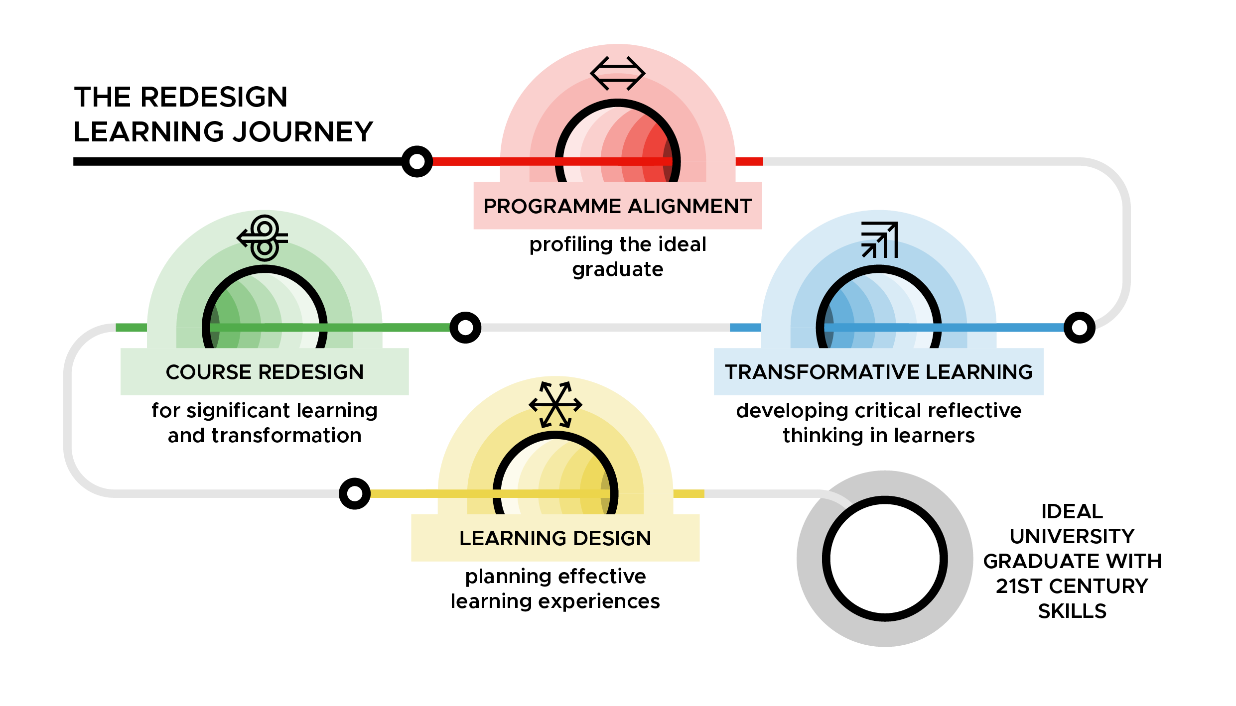
Overview of the Transformative Learning and Course Redesigning workshops
PA Slide 2.39

Slide 40
Workshop evaluation
Note to workshop facilitator: if you using an online form then insert the link here.
PA Slide 2.40

Slide 41
TESCEA was part of the UKAID-funded SPHEIR programme
The SPHEIR (Strategic Partnerships for Higher Education Innovation and Reform) programme supported higher education transformation in focus countries in Sub-Saharan Africa, Asia and the Middle East.
www.spheir.org.uk

