Slide 1
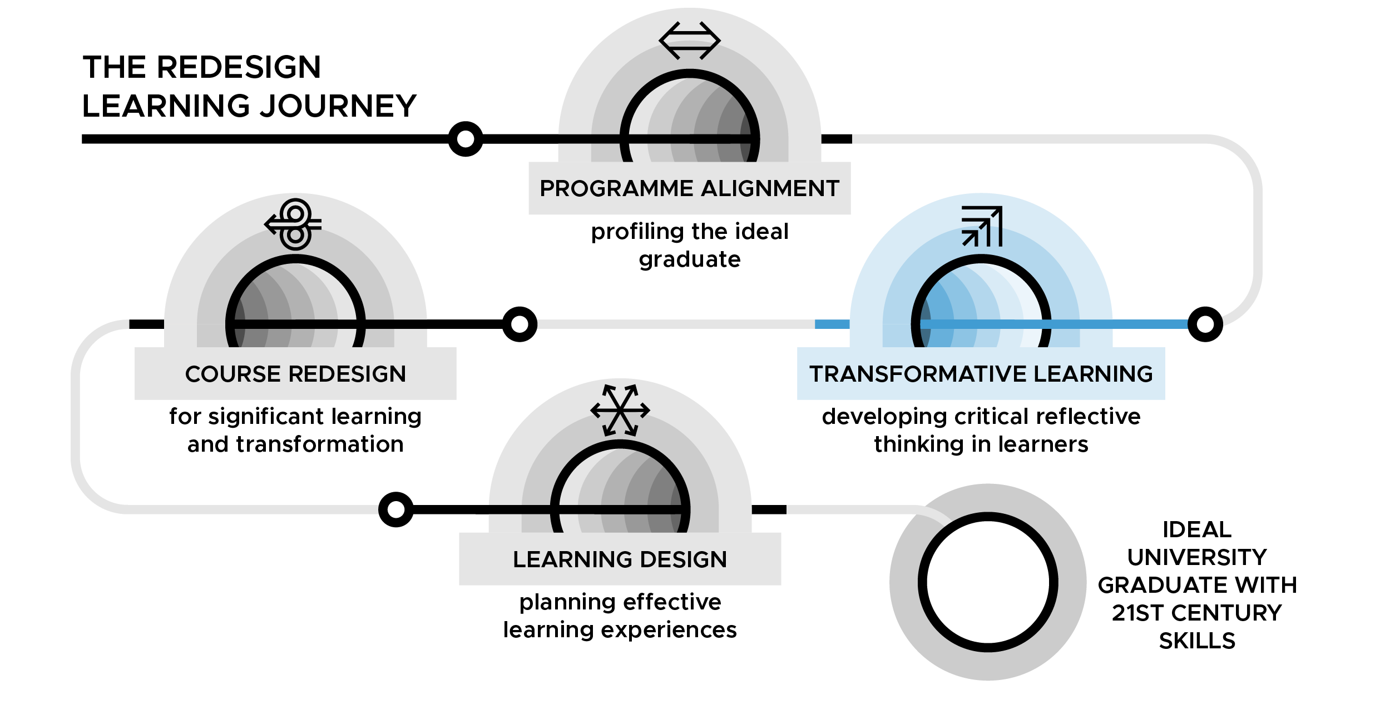
Transformative Learning - developing critical reflective thinking in learners
DAY 2

Slide 2
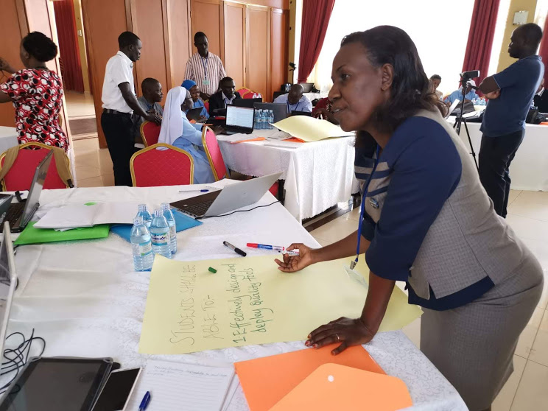
Day 2: Transformative learning
Uganda Martyrs University TESCEA Transformative Learning Workshop - Masaka, Uganda 2019
TL Slide 2.2

Slide 3
Learning outcomes for Day 2
By the end of Day 2, you will be able:
Explore what thinking is and how it can be made evident during the facilitation of learning
Apply appropriate strategies to promote thinking in your learning spaces
Interrogate the values, philosophy and pedagogy of Transformative Learning
Develop an effective single learning session following Transformative Learning principles
TL Slide 2.3

Slide 4
Gender dimensions
Gender is…
Representation
Equality/equity
Stereotypes and (conscious/unconscious) bias
Internalised bias
Interaction and space
Power (empowerment)
TL Slide 2.4

Slide 5
Gender is… representation
TL Slide 2.5

Slide 6
Gender audit of promotional material
Review the examples of promotional material for your university and answer the following questions:
Are there equal numbers of women and men represented in the materials?
What roles are women and men featured in (e.g. students, lecturers [or in our case facilitators of learning], researchers, administration, senior management)?
Are there equal numbers of women and men represented in each role and what are they doing?
How are women and men featured in different subject areas (in what roles and in what numbers)?
What language is used to describe women and men in the materials?
TL Slide 2.6

Slide 7
Individual reflection
What implications could the representation of men and women in the promotional materials have for prospective female students?
What implications could the representation of men and women in the promotional material have for prospective male students?
TL Slide 2.7

Slide 8
Global Gender Gap Country Report
The GGG report published by the World Economic Forum measures gender gaps across four dimensions:
Economic Participation and Opportunity
Educational Attainment
Health and Survival and
Political Empowerment
Link to find the latest report (2021) including all country reports:
www.weforum.org/reports/global-gender-gap-report-2021
TL Slide 2.8

Slide 9
Individual ‘thinking map’
Complete the 3-column pre-organiser on flipchart paper using sticky notes (15 mins)
Carry out a comparative analysis between your three lists i.e. to what extent does your first list match list two and three? and write down your reflections in Reflective space 2 in your handbook (5 mins)
TL Slide 2.9
Notes:
Notes

Slide 10
Group discussion based on pre-organisers
In your groups, discuss the below (15 mins)
If the three lists seem to be disconnected from one another, could you express what you feel is the problem and what you think would be a strategy to bridge the gap between list one and list two and list three?
If the three lists seem to connect, could you express what you feel are the characteristics that underpin their connection?
TL Slide 2.10
Notes:
Notes

Slide 11
If there a disconnect between lists 1, 2 & 3...
Your students may be more focused on work and activity than understanding
Your students may be doing more learning about the subject than learning to do the subject
You are not engaging your students in authentic intellectual activity
There is a need for you as a facilitator of learning to become more intentional about requiring your students to be involved in thinking activities
TL Slide 2.11
Notes:
Notes

Slide 12
Michael Sandel video: ‘Justice: What's The Right Thing To Do?
TL Slide 2.12
Notes:
Notes

Slide 13
Individual reflection (10 mins)
What stood out for you in both the reading and the video?
How do the reading and the video relate to each other?
What stood out for you in how Michael conducted his class?
How was thinking manifested in the class?
How will you support each other in creating and maintaining thinking environments within your learning spaces?
TL Slide 2.13
Notes:
Notes

Slide 14
Group discussion of key points (20 mins)
1. What similarities did you find? What differences did you find?
2. Concept map or illustrate your group’s key points, by clustering them under at least three main ideas on flip chart and then draw lines between the key ideas which you think are connected in some way.
3. Discuss what stood out for your group as the most significant underlying concept of this session and why?
TL Slide 2.14
Notes:
Notes

Slide 15
Introducing the Transformative Learning Cycle
Image source: www.pexels.com
TL Slide 2.15

Slide 16
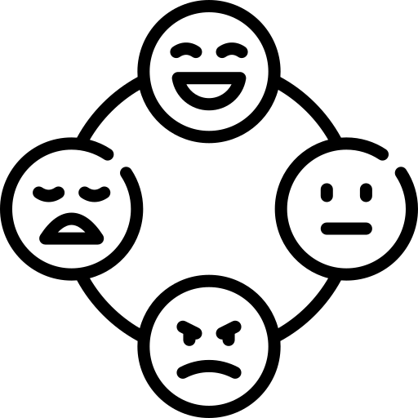
Phase 1: Concrete Experience
Concrete Experience
TL Slide 2.16

Slide 17
Phase 2: Reflective Observation
Concrete Experience
Reflective Observation
TL Slide 2.17

Slide 18
Phase 3: Abstract Conceptualisation
Concrete Experience
Reflective Observation
Abstract
Conceptualisation
TL Slide 2.18

Slide 19
Phase 4: Active Experimentation
Concrete Experience
Reflective Observation
Active Experimentation
Abstract
Conceptualisation
TL Slide 2.19

Slide 20
Group discussion of key points (20 mins)
1. What similarities did you find? What differences did you find?
2. Concept map or illustrate your group’s key points, by clustering them under at least five main characteristics on flip chart and then draw lines between the key ideas which you think are connected in some way.
3. Discuss what stood out for your group as the most significant underlying concept of this session and why?
TL Slide 2.20
Notes:
Notes

Slide 21
What do you think about the TL cycle and how its implementation within your classrooms or learning spaces links to making thinking visible?
Note to workshop facilitator: type up participant contributions from the plenary discussion here or write on a flip chart at the front of the room
TL Slide 2.21

Slide 22
Values & priorities of transformative learning
"Do not conform to the pattern of this world, but be transformed by the renewing of your mind” Romans 12: 2a
Image source: www.pexels.com
TL Slide 2.22

Slide 23
Values & priorities of Transformative Learning (Chip’s Creed)
1st Value: Learning over Teaching - should be the perspective of all facilitators of learning
2nd Value: Meaning Making over Sense Making - the priority is that students are actually learning
The other four values associated with transformative learning are a consequence of students being able
to make meaning.
These will be shared much later in this session.
TL Slide 2.23

Slide 24
Why are graduates today considered unemployable/ half-baked?
Image source: www.pexels.com
TL Slide 2.24

Slide 25
The Problem
Sometimes we find our students fail to make deep, personal meaning of their learning.
Students often understand content – at least enough to pass exams – but they fail to go deeper, to making meaning. They don’t have ownership – it does not become an integral part of their worldview.
TL Slide 2.25

Slide 26
Of all the songs originating in Africa, which is the most widely known and recorded in Africa and in the world?
TL Slide 2.26

Slide 27
Play the video:
Miriam Makeba - YouTube
Video One
TL Slide 2.27

Slide 28
Play the video:
Ladysmith Black Mambazo - YouTube
Video Two
TL Slide 2.28

Slide 29
Play the video:
The Tokens - YouTube
Video Three
TL Slide 2.29

Slide 30
So, who created this world-renowned song?
Solomon Linda wrote it and recorded it with his male
acapella group,
The Evening Birds.
TL Slide 2.30

Slide 31
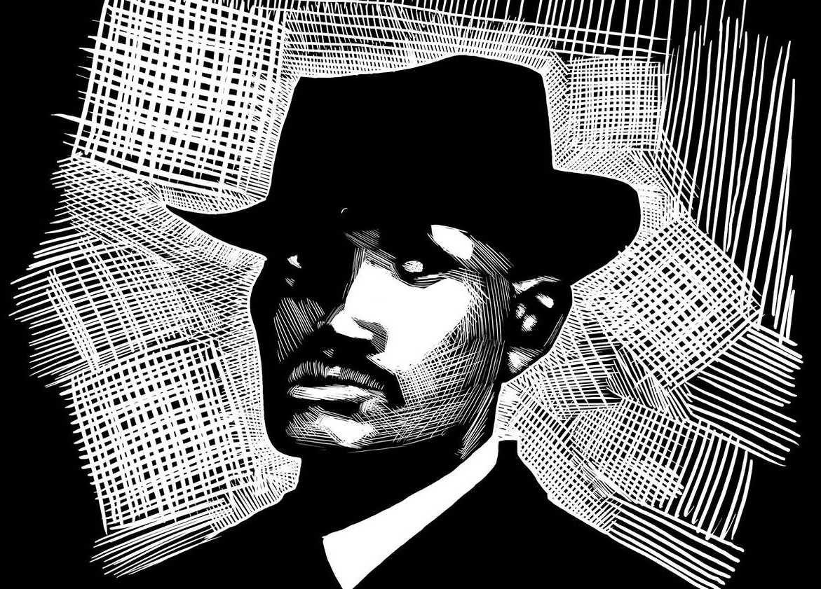
Solomon Linda wrote and recorded Mbube in 1939.
Over 1,000 covers of his song have been recorded and published – some selling millions of copies.
People made huge fortunes from his song.
He died a pauper in 1962
Source: https://alchetron.com/Solomon-Linda
“No copyright infringement is intended”
TL Slide 2.31

Slide 32
How do you feel about what happened to Solomon Linda?
TL Slide 2.32

Slide 33
Do you have music or videos on your phone, laptop, or other device, for which you have not paid for and have no legal right?
TL Slide 2.33

Slide 34
How do you feel about what happened to Solomon Linda?
Do you have music or videos on your phone, laptop, or other device, for which you have not paid for and have no legal right?
If so, and you are offended or angered by what happened to Solomon Linda, then you have made sense out of the concepts of ownership of creative property, but you have failed to make meaning of it.
TL Slide 2.34

Slide 35
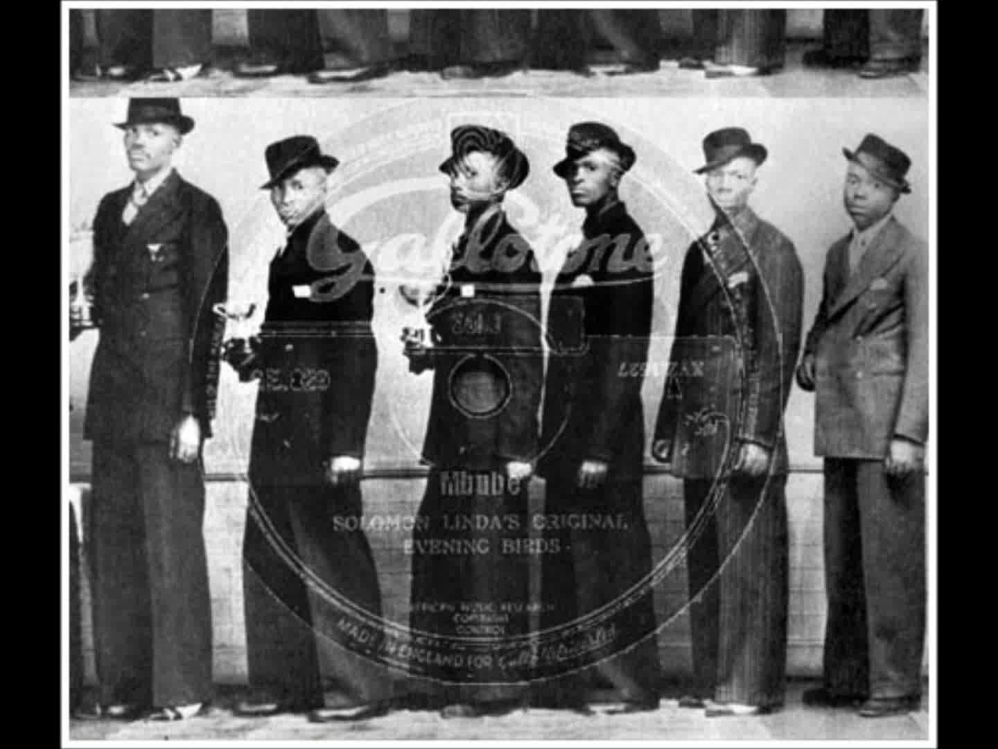
Play the video of the original song:
Solomon Linda &The Evening - YouTube
Source: https://alchetron.com/Solomon-Linda
“No copyright infringement is intended”
TL Slide 2.35

Slide 36
Group work (7 mins)
What would you say are some of indicators of when students are meaning-making over sense-making?
Sense-Making
Meaning-Making
_
_
_
_
_
_
_
_
_
_
_
_
_
_
_
_
TL Slide 2.36

Slide 37
Indicators of when students are meaning-making over sense-making
Sense-Making
Meaning-Making
“Oh, I See!”
“I understand”
“That makes sense”
“I’ll put that in my notes”
“Aha! Wow!”
Some personal emotional
reaction
“I get it! I’m going to ….”
Commitment to action
“Yes, I see how that connects to me”
Personal implications
“I’ll put that to work in my life” Sense of ownership
When students have made meaning, they will have a sense of ownership of the knowledge
TL Slide 2.37

Slide 38
Values & priorities of TL (Chip’s Creed) cont.
3rd Value Knowledge Creation over Knowledge Replication
4th Value Innovation over Tradition
5th Value Transformation over Information
6th Value Becoming over Knowing
These four values are also indicators of students moving from sense-making to meaning making.
TL Slide 2.38

Slide 39
Strategies for helping students to make meaning
Use PBL approaches
Use TL Cycle as a framework for designing learning activities
Ask students to create examples from (their) real life
Make papers, tests and other gradable assignments, personal – have students write about themselves in connection to the material being learned
In your grading rubric, reward meaning-making over sense-making
Transformation always takes place in process not in product – so commit time, energy, and resources to process.
TL Slide 2.39

Slide 40
End of Day 2 reflection
Note to workshop facilitator: if you using an online form then insert the link here.
TL Slide 2.40

Slide 41
TESCEA was part of the UKAID-funded SPHEIR programme
The SPHEIR (Strategic Partnerships for Higher Education Innovation and Reform) programme supported higher education transformation in focus countries in Sub-Saharan Africa, Asia and the Middle East.
www.spheir.org.uk

