Slide 1
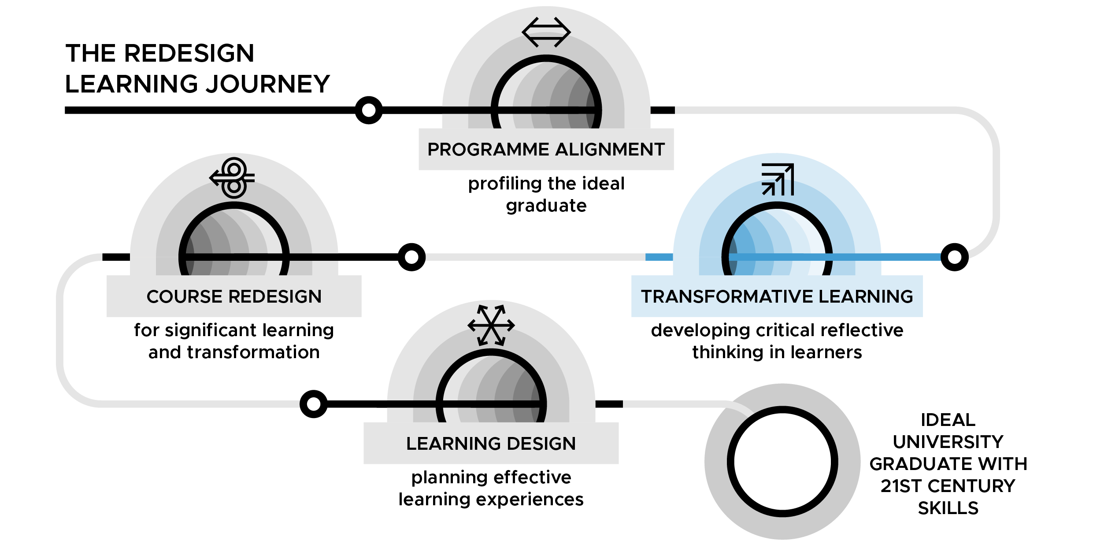
Transformative Learning - developing critical reflective thinking in learners
DAY 3

Slide 2
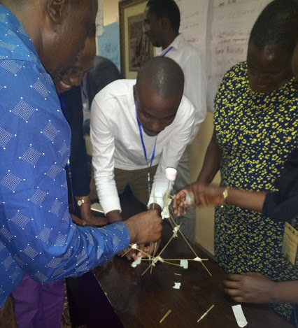
Day 3: Infusing critical reflective thinking into learning spaces
University of Dodoma & Mzumbe University TESCEA Transformative Learning Workshop - Arusha, Tanzania 2018
TL Slide 3.2

Slide 3
Learning outcomes for Day 3
By the end of Day 3, you will be able:
Create a learning environment where your students have the opportunity to exercise critical reflective thought.
Communicate the Big Dream for your course, which conforms to transformative learning values and principles, to your students and colleagues.
TL Slide 3.3
Notes:
Notes

Slide 4
Group discussion - 2 x pairs = group of 4
(8 mins)
Share the key points from your pair discussions
Articulate and note down the characteristics of these events that caused you to be so reflective
TL Slide 3.4
Notes:
Notes

Slide 5
Individual task
Read the handout ‘What is Critical Reflective Thought?’ (10 mins)
Organise your thoughts on the text, using the two pre-organisers in your handbook (10 mins)
TL Slide 3.5
Notes:
Notes

Slide 6
Group discussion (10 mins)
Share the similarities between your memorable life event and the ideas expressed in the handout.
Ideate on how as a group you can support each other in creating critical reflective thinking learning spaces.
Use flip chart paper to write down your group’s ideas.
TL Slide 3.6
Notes:
Notes

Slide 7
Individual reflection (15 mins)
Where do you fall on the continuum?
|------|------|------|------|------|------|------|------|------|------|
0 1 2 3 4 5 6 7 8 9 10
(Banking Concept) (TL Practice)
2. Are you facilitating learning for impact?
3. What are you doing well and what have you taken away that will inform your future facilitation of learning for transformation and impact?
4. What do you plan on doing moving forward?
TL Slide 3.7
Notes:
Notes

Slide 8
Individual review of how they all connect (10 mins)
Section 2.2: Programme (Curriculum) Matrix. Which PLO(s) does your chosen course contribute towards?
Section 2.1: Faculty/Programme Outcome Matrix. Which FMO(s) do the PLO(s) identified above contribute towards?
Section 1 Institutional information:
Faculty Promise to the students on the programme
University Promise to the students
Ideal University Graduate Profile
Section 3: Personal Teaching & Learning Philosophy
TL Slide 3.8
Notes:
Notes

Slide 9
Group reflection and discussion (20 mins)
Share your key reflections from questions b-d noted in your pre-organiser for the Big Dream.
Now probe each other’s reflections a little further:
Can you envision who your students can/will BECOME and not just what they should KNOW?
Can you clearly articulate what they MUST KNOW?
Can you therefore describe what they MUST DO in your classrooms so that they can/will BECOME?
TL Slide 3.9
Notes:
Notes

Slide 10
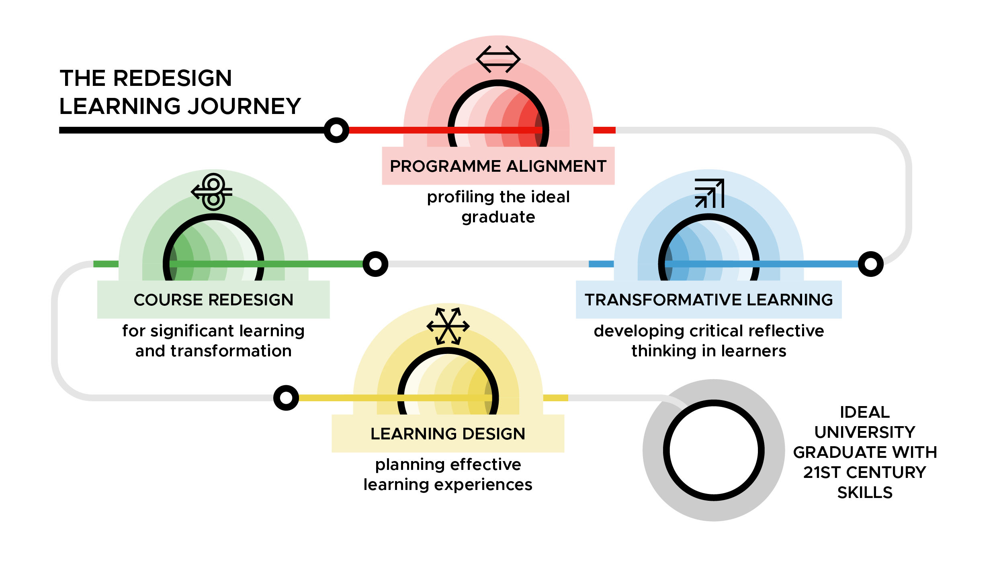
Overview of the ‘Course redesign for significant learning and transformation’ face-to-face workshop and online course
TL Slide 3.10

Slide 11
Workshop Evaluation
Note to workshop facilitator: if you using an online form then insert the link here.
TL Slide 3.11

Slide 12
TESCEA was part of the UKAID-funded SPHEIR programme
The SPHEIR (Strategic Partnerships for Higher Education Innovation and Reform) programme supported higher education transformation in focus countries in Sub-Saharan Africa, Asia and the Middle East.
www.spheir.org.uk

